Slide 1
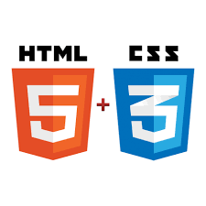


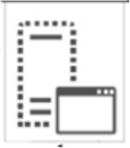

Contenu éditorial, pages statiques, images, etc.
CMS
SOAP
BOOKIT end-point services
REST
UI end-point services
Données brutes XML
REST
BOOKIT end-point services
Données brutes JSON
front
back
TOMCAT
Middle layer gateway
App. API Server
session
entity
HOGIA
B2B/B2C
Database server

